Slide 1

Welcome!
Intro to DevSecOps

Slide 2


Hello
About me...
30 years in the industry
25 years in teaching
Certified Cloud architect
Passionate about learning
Also, passionate about Reese’s Cups!
Allen Sanders
Senior Technology Instructor
Pluralsight ILT
Notes:
After introducing self, have students introduce themselves:
Name?
How long with the company?
What are you hoping to come away from this training having gained in terms of knowledge and/or information that you can take back with you to your teams and your day-to-day role?

Slide 3
Agenda
Learning objectives
CI/CD as a capability / differentiator
DevSecOps – what it is and why it is needed
Practicing DevSecOps at each phase of the SDLC
OWASP Top 10

Slide 4
How We’re Going to Work Together
Slides and words to highlight key concepts
Demos to bring those concepts “to life”
Discussion groups and lab work (which will take place in sandboxes provided via AWS WorkSpaces) for hands-on reinforcement
NOTE: I welcome being interrupted – if you need more info, or clarification, or anything else, just break in and ask. I am here to help you.

Slide 5
Learning Objectives

Slide 6

Learning Objectives
Understand key concepts and considerations when leveraging DevSecOps in an Agile environment to help “shift security left” during software development
Construct and prioritize a threat model for an application being developed and use that threat model as a planning tool to guide each phase of the SDLC in a security-minded manner
Speak to the value of DevSecOps and its consistent application as a set of standards and best practices

Slide 7
Learning Objectives
Monitor, patch and scan for vulnerabilities in the Operating System (Windows and Linx) and underlying Infrastructure configuration
Effectively utilize GitLab for Source Code Management and CI/CD, including:
Understanding and navigating practical activities related to source code repositories in GitLab
Effectively use Software Composition Analysis (SCA), Static Application Security Testing (SAST), and Dynamic Application Security Testing (DAST)
Notes:
GitLab: repository creation and branching, integration of automated testing into the pipeline, creating and processing merge requests to support Continuous Integration of changes across the development team, and integration with an artifact repository for storing build outputs

Slide 8
CI/CD as a Capability / Differentiator

Slide 9
What a difference 45 minutes can make!!

Slide 10


How Long Does it Take for a Company to Go Bankrupt?
If the circumstances are right, it can happen in just 45 minutes!
Notes:
We’re going to talk about an (albeit extreme) example of what can go wrong in the deployment of new software and how lack of DevSecOps practices at one company (Knight Capital Group) resulted in a $460M loss in just 45 minutes.

Slide 11











Knight Capital Group – What Happened?
Automated Stock
Trading System
Receives Large
Trading Orders
(“Parents”)
Automates Breakup
into Smaller
“Child” Orders
Manual
Deployment to
Eight Servers
New Functionality
Thoroughly Tested
Repurposed Old
Code to Implement
Trading Starts
(9:30 a.m.)
One Server Missed
(Human Error)
Serious Problem
Experienced Live
10:15 a.m.
Tried Frantically
to Fix
Missed Server Not
Bounding “Child” Orders
Against “Parent” Size
$460M loss vs. $365M in assets!
Source: https://dougseven.com/2014/04/17/knightmare-a-devops-cautionary-tale/
Notes:
Talk through the details of the specific scenario
For tried frantically to fix – no good observability/messaging for troubleshooting; assuming issue with new code, rolled back all new code which left the 7 “good” servers with the same problem as the 1 “bad” one.

Slide 12
DevOps – What it is & why it’s valuable

Slide 13


Approach Used In the “Olden” Times
#$@&%*!!!
Development
Operations
#$@&%*!!!
Development & Operations siloes
Lack of understanding of the other perspective
Lack of communication & partnership
“Fire and forget” engagement

Slide 14


DevOps – The New Way
Development
Operations
Development & Operations work together
Each understands & appreciates the position of the other
Good communication, partnership, & collaboration
Ongoing engagement – continuous improvement

Slide 15
DevOps – The Three Ways
The First Way: Flow/Systems Thinking
Business
Customer
Source: Gene Kim (https://itrevolution.com/the-three-ways-principles-underpinning-devops/)
Development
Operations
Holistic vs. siloed view – success is defined by the performance of the entire system vs. a specific team or individual
Starts with requirements (defined by the business) and not called “done” until value is delivered to the customer
Target outcomes:
Known defect never passed to downstream teams
Favor global performance vs. focusing on local optimization
Goal is increased flow (value)
Asking ourselves the question: “What don’t I know about our systems?”

Slide 16
DevOps – The Three Ways
The Second Way: Amplify Feedback Loops
Source: Gene Kim (https://itrevolution.com/the-three-ways-principles-underpinning-devops/)
Development
Operations
Create right-to-left feedback loops
Shorten & amplify so information needed to make continuous improvements & continuous correction is readily available
Target outcomes:
Understanding all customer perspectives (internal & external)
Responding to all customer concerns (internal & external)
Knowledge is power!

Slide 17

DevOps – The Three Ways
The Third Way: Culture of Continual Experimentation & Learning
Source: Gene Kim (https://itrevolution.com/the-three-ways-principles-underpinning-devops/)
Development
Operations
Culture that fosters:
Continual experimentation, risk-taking, and learning from failure
Practice makes perfect!
Target outcomes:
Allocating time for continual improvement (e.g., resolution of technical debt as a standard “category” of work)
Taking calculated risks and seeing them pay off – No guts no glory!
Expecting failure & building resiliency into the process
Notes:
Risk aren’t bad – reckless risks are

Slide 18
DevSecOps

Slide 19
The Mindset

Slide 20
DevSecOps
What is it?
Discipline that takes into consideration how People, Processes, and Tools Automation combine to ensure we have:
Disciplined build of security into all phases of SDLC
Just-in-time security assessment and testing
Security as a “shared responsibility”
Notes:
Distributes security concerns to all teams using tooling to help automatically fill in gaps in experience or understanding

Slide 21
DevSecOps
Why is it important?
To maintain a competitive advantage:
We need to deliver software quickly
We need that software to have high quality
We need that software to be secure
We want to merge speed & agility with security & quality!
Notes:
Automation with quality assurance built into the pipeline and security applied at each phase

Slide 22
DevSecOps and how can businesses benefit from it?
DevSecOps integrates software development with IT/SEC operations, leveraging automation to shorten the product life-cycle and enable frequent deliveries aligned with the business needs, while ensuring quality
DevSecOps Building Blocks
Impact Levers
Continuous integration
Automated testing and single source code mgmt. system
Speed
Release in days, not months
Continuous delivery
Ability to deliver software when ready
Quality
Enable speed and enhance stability with rigor and confidence
Continuous deployment
One-click release of software to live
Continuous monitoring and autonomic operations
Highly automated IT Operations, including security, vulnerability scanning
Efficiency
Operate in automated environment and focus on high value tasks
Standardized and automated infrastructure mgmt. with built in security
Automate environment with infrastructure-as-a-code (IaC),
Security
Baked-in and fully integrated into SDLC

Slide 23

Security in Software Engineering – The Traditional Way
Not enough time in schedule to absorb changes required to remediate
Activities required to remediate may be complex
Security issues require revisit of one or more previous phases
Release
Plan
Operate
Test
Develop
Feedback

Slide 24
Security in Software Engineering – A Better Way
Release
Plan
Operate
Test
Develop
Feedback

Slide 25
Security in Software Engineering – DevSecOps
Additional security-specific scanning, port scans, and log validation
Threat modeling, data protection, and risk assessment
Release
Plan
Operate
Test
Develop
Monitoring & alerting, RCA (Root Cause Analysis)
Feedback
SAST (Static Application Security Testing) and SCA (Software Composition Analysis) tooling
DAST (Dynamic Application Security Testing) tooling

Slide 26

Security in Software Engineering – DevSecOps
Information gathered from early phases feed into later phases
In true DevOps fashion, lessons learned feed continuous improvement
Release
Plan
Operate
Test
Develop
Feedback
Quality gates guard against moving security defects forward

Slide 27
DevSecOps in Plan

Slide 28
Assessing Security Risks (Plan Phase)
To secure a solution, attack surfaces and potential threats must be identified
Common practice utilizes something called threat modeling
Includes modeling and analyzing possible attack vectors based on application profile

Slide 29
Assessing Security Risks
Risk assessment should account for different “zones” of execution
Security requirements must be understood in context of specific use cases
Ideally, threat modeling would be executed during the plan phase and results would be used to inform other phases
Hardware & OS
Software
Network
Database

Slide 30
Threat Modeling
Can be viewed in two different, but related, contexts:
Implementation of controls mapped to security requirements & policy (prevention)
Implementation of countermeasures against possible known attacks (remediation)

Slide 31
Threat Modeling
Multiple approaches:
Attacker-centric (think like an attacker!)
Asset-centric (what do we have to lose?)
Application-centric (what are we building & testing?)

Slide 32
Threat Modeling – Key Considerations
Valuable principles:
Defense in Depth
Principle of Least Privilege
Secure by Default

Slide 33

Overview of the STRIDE Methodology for Threat Modeling
S
poofing
T
ampering
R
epudiation
I
nformation Disclosure
D
enial of Service
E
levation of Privilege
Notes:
Used to help catalog types of threats

Slide 34
S
poofing
Illegally accessing another user’s identity or authentication information
Used when interacting with a system to make the system think you’re someone else (with permissions that you don’t actually have)
Can include things like username and password, IDs, access keys, passkeys, etc.
Notes:
Like Mission Impossible

Slide 35
T
ampering
Malicious modification of data
Can include interception and modification in-transit
Can also include interception and modification at rest (like in a database)

Slide 36
R
epudiation
Taking advantage of vulnerabilities in a system or workflow that allows a user to take an action without the system being able to confirm, audit, or prove the action
In a DevSecOps context, allowing a user to take a prohibited action or access secure information anonymously and with deniability

Slide 37
I
nformation Disclosure
Exposure of sensitive information that a user or party should not have access to
Extremely harmful when juxtaposed against regulations like HIPAA or PCI

Slide 38
D
enial of Service
Involves an attacker sending significant amounts of “bogus” traffic to your system or service
System becomes overwhelmed and is unable to handle real traffic
Goes to a site or service’s reliability and availability

Slide 39
E
levation of Privilege
Allowing an unprivileged user to gain privileged access to a system
Failing to minimize zones of implicit trust such that once an attacker has invaded, they are granted more access than they should have
Notes:
Lack of practice of zero trust (castle & moat vs. hotel)

Slide 40
Defining Objectives and Scope
01
02
03
Critical Asset Identification
Threat Environment Analysis
User Role Specification
Establish a clear inventory of assets requiring protection, ensuring that security measures are focused on the most valuable components of the system
Assess the external threat landscape, including potential adversaries and attack vectors, to inform the scope and focus of the threat modeling process
Clearly define user roles and their permissions to identify potential security vulnerabilities related to unauthorized access and privilege escalation

Slide 41


Creating a System Architecture Diagram
01
02
Visual Representation Benefits
Security Analysis Framework
A System Architecture Diagram provides a clear visual representation of system components and their interactions, enhancing stakeholder comprehension and facilitating effective communication across diverse teams
The diagram serves as a foundational tool for security analysis, enabling teams to systematically identify and prioritize potential threats by mapping data flows and trust boundaries within the system
41

Slide 42
Identifying Assets & Entry Points
Comprehensive Asset Inventory
Conduct a thorough inventory of all assets
Categorize according to sensitivity and criticality
Entry Point Risk Assessment
Evaluate each identified entry point for potential vulnerabilities
Implement security measures tailored specifically to mitigate risks associated with unauthorized access
Continuous Monitoring Practices
Establish ongoing monitoring of assets & entry points
Include change and emerging threat detection
Use to drive protection focus
Helps drive timely updates to security protocols and strategies for response

Slide 43
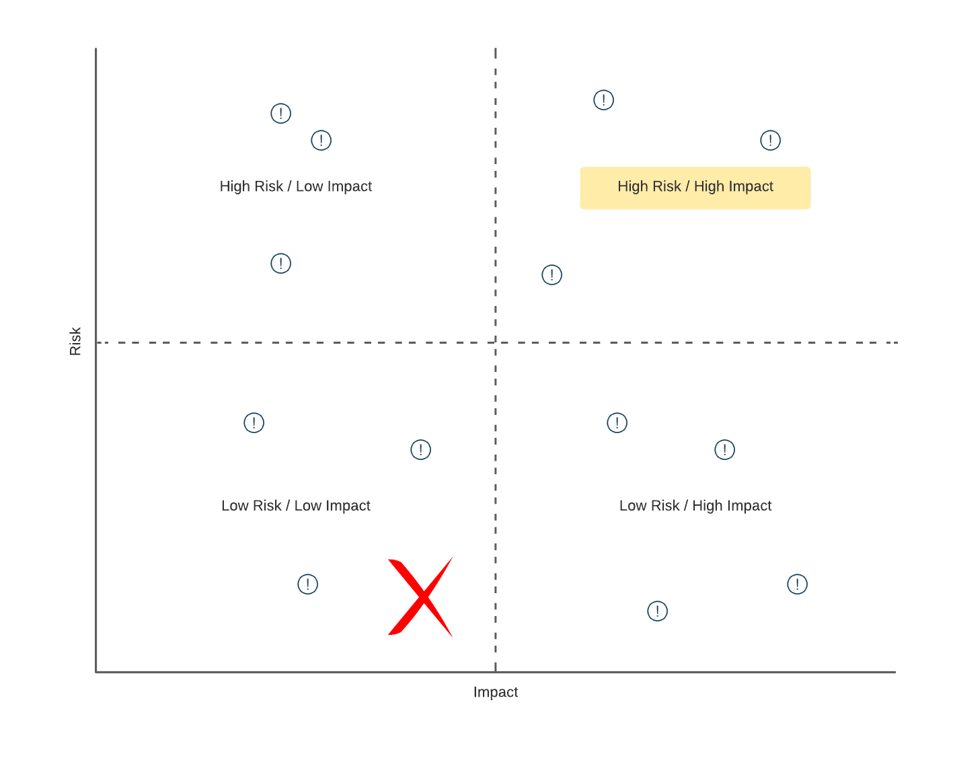
Prioritizing Threats

Slide 44
MITRE ATT&CK Framework
Can be combined with STRIDE (or other frameworks) to help drive a deeper, more detailed analysis of and plan for potential threats
Provides a comprehensive set of potential attack vectors to consider in multiple areas of focus
Also, provides information on examples of the attack, mitigation strategies, and detection strategies

Slide 45
LAB:
In your assigned breakout room, visit https://attack.mitre.org and complete a high-level review of the set of security concerns and the associated techniques listed there. Each team will pick 3 of the techniques (pick 3 that your team finds most interesting or considers most relevant). Drill down into each selected technique and, as a team, document the following for “teach back” to the larger group:
Brief description for the attack technique
Detail on one mitigation (if any exist for the technique)
Detail on one detection approach
Nominate someone from your breakout room to gather/document the results of the discussion. That person will present to the larger group when we come back together from our sub-teams.
Mitre ATT&CK Framework

Slide 46
LAB:
In your breakout room, review the assigned scenario. Complete the following:
Review the scenario
Identify critical assets in scope
Create a high-level system architecture diagram
Assess the internal and external threat landscape – brainstorm, discuss, and document as many potential threats and attack vectors that you see in the defined architecture (use STRIDE and Mitre ATT&CK to assist)
What kind of monitoring would you recommend?
Finally, as a team, prioritize each potential threat relative to the others by assessing risk vs. impact
Threat Modeling
Don't forget to include the following considerations:
Hardware & OS
Software
Data
Network
Each team will present their architecture diagram and their prioritized list of potential threats/attack vectors to the larger group.
Notes:
The large group will be the ARB (Architecture Review Board)

Slide 47
DevSecOps in Development

Slide 48

Shifting Security Left – Develop
Ideally, security flaws in code would be caught on a developer’s machine
Can use plugins for IDEs to provide automated static analysis
In some cases, tools can be configured with custom rules and priorities

Slide 49
Shifting Security Left – Develop
Rulesets and priorities should be driven by results of threat modeling
Scanning tools if used should be a standard part of all developer’s code tooling, to ensure consistently applied (standard dev build)
Goal is to catch issues VERY early on in the SDLC

Slide 50

Moment of Reflection
What is the most “secure” programming language in use in the industry today?
Type your answer in chat
Notes:
https://www.whitesourcesoftware.com/most-secure-programming-languages/

Slide 51
DevSecOps in Build

Slide 52
Shifting Security Left – Build
Changes from a developer are ready to be integrated with others
Typically driven through submission of Pull Request in GitHub
Notifies a peer that changes are pending and need review

Slide 53
Shifting Security Left – Build
In addition to logic/syntax errors, peer reviewer can focus on areas of high risk/high impact identified in threat modeling
In some cases, a specialist peer reviewer (e.g., one from InfoSec) can be engaged to validate security of code

Slide 54
Shifting Security Left – Build
Coupled with manual review, SAST (Static Application Security Testing) tools can be integrated into CI/CD to automate security checks
Tools like Veracode can be integrated into pipeline via plugins (https://docs.veracode.com/r/c_integration_buildservs)
Some even include ability to capture scan results in resulting build report and use results of scan as quality gate to prevent move forward on failure

Slide 55
Shifting Security Left – Build
SCA (Software Composition Analysis) tools also provide benefit
Tools like Mend.io (https://www.mend.io/open-source-security) can be integrated into CI/CD for automated security scans of Open-Source components
Ideally, governance would be in place to monitor and manage “accepted” set and versions of Open-Source tools approved for usage
Notes:
Like an artifact repository – e.g., npm modules, Docker images, Python packages, etc.
Developers and builds would pull from these repositories instead of the Internet

Slide 56
Shifting Security Left – Build
SCA tools can provide a couple of benefits
Primarily, security scans can be executed, and Open-Source vulnerabilities identified
Secondarily, can help an organization catalog the Open-Source components (and versions) “in play” already

Slide 57
Shifting Security Left – Build
Resulting report can be used to identify components that have not been properly vetted through governance
Results can be merged with overall build output
Quality gates (manual or automated) can be built around results to prevent move forward if insecure

Slide 58
Moment of Reflection
Answer the following question: Using an open-source library is more secure than building something custom? Yes or no, and why.
Type your answer in chat
58

Slide 59
LAB:
Using the threat model your team created for your scenario as part of the previous exercise, discuss in your breakout room how you intend to handle the prioritized threats during the develop/build phase of the SDLC.
Be as specific as possible:
What manual processes will you use to validate security at this stage?
What automated processes will you use to validate security at this stage?
What suggestions would you offer for reporting and responding to findings?
How would you reduce friction at this phase to ensure we’re able to not only move safely but also quickly?
What concerns you most at this stage?
Each team will present their thoughts & ideas to the larger group.
Develop & Build
Notes:
The large group will be the ARB (Architecture Review Board)

Slide 60
DevSecOps in Test

Slide 61
Shifting Security Left – Test
Includes changes ready for move to QA for additional testing
Dynamic Application Security Testing (DAST) tools provide more sophisticated vulnerability checks
Dynamically exercise application’s runtime interfaces using injected data

Slide 62
Shifting Security Left – Test
DAST tools can use complex combinations of invalid input via fuzzing (https://triotechsystems.com/fuzz-testing-in-dast-what-it-is-and-how-to-implement-it)
Provides multiple layers of protection
A tool like OWASP Zed Proxy or OWASP ZAP is an example (https://www.zaproxy.org)

Slide 63
Shifting Security Left – Test
Two types – passive scan and active scan
Passive scan less aggressive and minimizes use of fuzzing
As a result, not as robust in its ability to find exposure but also takes less time to run

Slide 64
Shifting Security Left – Test
Because of that, passive scan can be good fit for CI/CD pipelines, especially those that look to push updates at a greater frequency
For the C (continuous) part, need flows to complete quickly
Notes:
Quickly is relative

Slide 65
Shifting Security Left – Test
Active scans are more aggressive in their attack approach
Make extensive use of fuzzing to elevate level of attack sophistication
Send multiple requests, continually altering request data to simulate attack payloads

Slide 66
Shifting Security Left – Test
Can also make use of a technique called “spidering”
Allows the scan to crawl a site or service to simulate sequenced or multi-level attacks (stateful attacks)
Can be very effective in securing a site or service but also takes much longer to execute (due to added complexity and sophistication)

Slide 67
Shifting Security Left – Test
Because of its more aggressive nature, should only be executed against owned sites and in a sandboxed environment (risky)
Often active scans are scheduled to occur out-of-band on a regular basis (weekly, nightly, etc.)

Slide 68
Shifting Security Left – Test
In addition to the automated scans, traditional functional test scripts and manual testing may be used
Should include security-focused testing as well (or in separate PEN testing)
Tests should be informed by prioritized set of vulnerabilities identified during threat modeling

Slide 69
Moment of Reflection
Which type of dynamic scan (passive or active) is more effective, and why?
Type your answer in chat
69

Slide 70
LAB:
Using the threat model your team created for your scenario as part of the previous exercise, discuss in your breakout room how you intend to handle the prioritized threats during the test phase of the SDLC.
Be as specific as possible:
What manual processes will you use to validate security at this stage?
What automated processes will you use to validate security at this stage?
What suggestions would you offer for reporting and responding to findings?
How would you reduce friction at this phase to ensure we’re able to not only move safely but also quickly?
What concerns you most at this stage?
Each team will present their thoughts & ideas to the larger group.
Test
Notes:
The large group will be the ARB (Architecture Review Board)

Slide 71
DevSecOps in Release

Slide 72
Shifting Security Left – Release
Software confirmed ready for release
Often deployed to a pre-prod environment (like staging)
Can include automated “smoke” testing

Slide 73
Shifting Security Left – Release
This phase may also include security-specific scans as a “last mile” protection
SAST, SCA, and DAST scans may be repeated in this environment as a double-check
Port scans can also be used (depending on how closely this env matches prod) to help validate exposure at network communication layer

Slide 74
Shifting Security Left – Release
Additionally, this stage can utilize application logging as a type of validation
Provides a unique opportunity to confirm correct sanitization of log detail
Also, can include verification of specific AuthN/AuthZ controls prior to a prod release

Slide 75
Moment of Reflection
What other types of security checks (besides rerunning SAST, SCA, and DAST scans) are effective as part of the Release phase?
Type your answer in chat

Slide 76
DevSecOps in Operate

Slide 77
Shifting Security Left – Operate
In this stage, monitoring and alerting become paramount for capturing and notifying support of any security exposure “in the wild”
System logs, telemetry, and event detail become useful
Likely not everything will be found prior – ongoing vigilance is a must

Slide 78
Shifting Security Left – Operate
When (not if) something happens, Root Cause Analysis (RCA) is important
Helps with understanding the why
Can also help with identifying short-term workarounds (to stop the bleeding) and long-term fixes (for enhancement prioritization)

Slide 79
Shifting Security Left – Operate
Preceding detail can feed dashboards or reports to help stakeholders visualize the security posture of the system and org
System logs can also be used to satisfy auditing requirements (depending on the industry)
Key Performance Indicators (KPIs) can be used to measure

Slide 80
Shifting Security Left – Operate
Examples
Number of security-related tickets
Build or release delays caused by security alerts
Mean time to compliance
These can all help support the Continuous Improvement function in the area of security focus

Slide 81
Moment of Reflection
What is one Key Performance Indicator (KPI) or metric you would recommend using (or have used) to evaluate the security posture of a system running in production?
Type your answer in chat
81

Slide 82
LAB:
Using the threat model your team created for your scenario as part of the previous exercise, discuss in your breakout room how you intend to handle the prioritized threats during the release & operate phases of the SDLC.
Be as specific as possible:
What manual processes will you use to validate security at these stages?
What automated processes will you use to validate security at these stages?
What suggestions would you offer for reporting and responding to findings?
How would you reduce friction at these phases to ensure we’re able to not only move safely but also quickly?
What concerns you most at these stages?
Each team will present their thoughts & ideas to the larger group.
Release & Operate
Notes:
The large group will be the ARB (Architecture Review Board)

Slide 83
Additional Considerations

Slide 84
Other Key Considerations - SAST
Be aware that SAST tools have the propensity for false positives (depending on tooling employed)
Tools may err on the side of caution with security scans
Might require that an organization customize the tool to more accurately report on environment and application
Otherwise, teams run the risk of wasting time on non-value add activities, impeding “frictionless security”

Slide 85
Other Key Considerations - Containers
If application profile includes containers or container orchestration (k8s), additional consideration required relative to security of images
Tools like Aqua (https://www.aquasec.com) and Prisma Cloud (https://www.prismacloud.io/prisma/cloud/cloud-workload-protection-platform) can help with scanning of container images

Slide 86
Other Key Considerations – Sensitive Config
Sensitive configuration data and app secrets (e.g., connection strings, passwords, etc.) should never be hardcoded in source
Run the risk of checking into and exposing via source control
Tools like truffleHog (https://github.com/dxa4481/truffleHog) can help with repo scanning

Slide 87



Key Benefits of DevSecOps (In Summary)
Proactive Security Measures
Fostering Team Collaboration
Streamlined Compliance Processes
By integrating security early in the development lifecycle, organizations can identify vulnerabilities sooner, significantly reducing the risk of breaches and enhancing overall application security.
DevSecOps promotes a culture of collaboration among development, security, and operations teams, leading to improved communication, faster problem resolution, and a unified approach to security challenges.
Continuous compliance through automated checks within CI/CD pipelines ensures that security standards are consistently met, minimizing the risk of regulatory penalties and enhancing operational integrity.

Slide 88
OWASP & OWASP Top 10

Slide 89
OWASP & Its Importance

Slide 90

Introduction to OWASP
OWASP’s role in security:
Provides essential resources & frameworks
Empowers organizations to identify, manage, and mitigate security vulnerabilities
Seeks to build a culture or security awareness and proactive risk management

Slide 91

The Role of OWASP in Security
Educational Resources and Training
OWASP provides comprehensive educational materials and training programs, equipping developers with the knowledge to address and mitigate security threats effectively
Advocacy for Security Standards
Open-Source Security Tools
OWASP promotes essential security standards and practices, guiding organizations to integrate security into their software development processes from the outset
OWASP develops and maintains open-source tools, such as ZAP, enabling organizations to identify vulnerabilities without incurring significant costs, thus enhancing overall cybersecurity

Slide 92
Overview of the OWASP Top 10
Critical Security Risks Identified, Tracked, and Documented
Informs Risk Management Strategies, Helps Prevent Financial Losses, and Protects Brand Reputation
Notes:
The OWASP Top 10 highlights the most significant web application security risks, providing a prioritized framework for organizations to address vulnerabilities effectively and enhance their security posture.

Slide 93
LAB:
In your assigned breakout room, visit https://owasp.org/www-project-top-ten and complete a high-level review of the application security risks your team was assigned. Drill down into each and, as a team, document the following for “teach back” to the larger group:
Brief description for the risk (2 – 3 bullets)
Summary of how to prevent (2 – 3 bullets)
Information on an example of an attack scenario
Nominate someone (different) from your breakout room to gather/document the results of the discussion. That person will present to the larger group when we come back together from our sub-teams.
OWASP Top 10 - Intro

Slide 94
OWASP Top 10 Vulnerabilities

Slide 95




Types & Examples
01
02
03
SQL Injection Risks
Command Injection Exploits
XSS Attack Variants
SQL Injection can lead to unauthorized data access, manipulation, and potential system compromise, emphasizing the need for robust input validation and sanitization.
Command Injection allows attackers to execute arbitrary commands on the server, highlighting vulnerabilities in input handling and the importance of strict validation measures.
Cross-Site Scripting (XSS) can steal sensitive user information through malicious scripts, necessitating effective input sanitization and user trust management in web applications.

Slide 96
SQL Injection
Attacker injects SQL (Structured Query Language) queries into app flow (e.g., UI)
In some cases, injected SQL used to retrieve additional sensitive detail
In other cases, injected SQL used to alter or damage a company’s critical data

Slide 97
Types of SQL Injection Attack
In-band
Blind

Slide 98
In-band SQL Injection
Uses existing channel of communication for an attack
Error-based – attacker performs actions that cause errors in order to gather “intel” about database structure
Union-based – attacker takes advantage of UNION SQL operator to fuse multiple SELECT statements into single response

Slide 99
Blind SQL Injection
Attacker sends separate, independent data queries to a server
Called blind because results of query are not sent back to attacker
Instead, attacker observes results to infer vulnerabilities

Slide 100
Blind SQL Injection
Relies on response and behavior patterns of server so slower to execute
Boolean – attacker sends SQL query to database and determines if attack valid based on response received (true or false)
Time-based – attacker sends SQL query to database and determines if attack valid based on amount of time taken to process

Slide 101
Defending Against SQL Injection
Use well-defined contracts to explicitly map expected results from application
Sanitize inputs and use parameterized queries in code
Use a Web Application Firewall that includes protections at the application layer (including protection against SQL Injection)

Slide 102




Risks & Mitigations
Unauthorized Access Prevention
Implementing strong authentication measures reduces the risk of unauthorized access to sensitive user data and protects against identity theft.
Session Management Best Practices
Effective session management, including secure token handling and session expiration, is crucial to prevent session hijacking and unauthorized account access.
Regular Security Assessments
Conducting frequent security audits and vulnerability assessments helps identify weaknesses in authentication processes, enabling timely remediation and enhanced security posture.

Slide 103
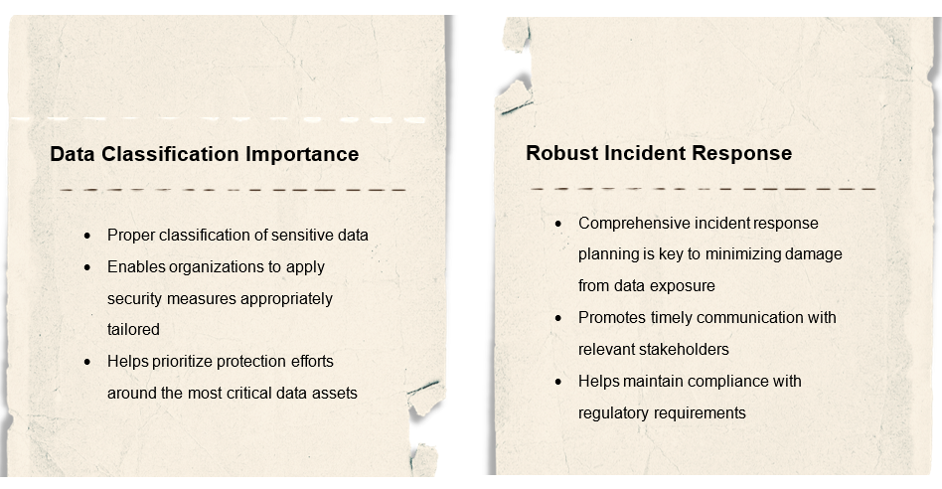
Prevention Strategies

Slide 104
Security Misconfiguration
Impact of Default Settings
Default configurations often lack necessary security measures
Vigilance and active management is required to ensure attack vectors are not exposed
Importance of Regular Updates
Failure to apply security patches to the infrastructure on which systems are running can leave systems exposed
There should be a well-defined and regimented set of procedures in place for applying
Role of Access Controls
Properly configured access controls are essential
Misconfigured permissions can lead to data leaks and unauthorized actions
Requires rigor in process around access management

Slide 105
Best Practices for Configuration Management
Accurate Configuration Inventory
Baseline Configuration Review
Change Management Documentation
Notes:
Regularly update and verify the inventory of configuration items to ensure all assets are accounted for and properly managed
Periodically reassess baseline configurations to adapt to new security threats and technological changes, ensuring ongoing compliance and security
Maintain detailed records of all configuration changes, including rationale and testing outcomes, to facilitate audits and enhance accountability
Tools for identifying misconfigurations – Static Analysis Tooling and Dynamic Analysis Tooling

Slide 106

Types of XSS (Cross Site Scripting) Attacks
Reflected XSS Mechanism
Relies on immediate execution of scripts reflected from user input, often requiring user interaction through crafted links to trigger the attack
Stored XSS Characteristics
DOM-Based XSS Dynamics
Involves persistent storage of malicious scripts, affecting multiple users who access the compromised content, leading to widespread exploitation
Occurs entirely on the client side, manipulating the DOM without server interaction, highlighting the importance of secure client-side coding practices
Notes:
A type of injection – but script instead of SQL
Attacker uses inputs to attempt injection of a <script>…</script> element
An example could be posting a comment with a link that routes to a malicious site

Slide 107
Cross Site Scripting (XSS)
Without inspection for malicious content, <script> can be returned (and executed) in user’s browser
Malicious content can include JavaScript, HTML, Flash, etc.
Really, any code that browser can execute

Slide 108
Cross Site Scripting (XSS)
Common forms of attack:
Stealing cookie or session information
Redirects to web content controlled by an attacker
Executing malicious operations on user’s machine
Leveraging impersonation for elevated privilege

Slide 109
Cross Site Scripting (XSS)
Stored XSS attacks:
Injected script permanently stored on target servers
Could include storage in database, forum, comment field, etc.
Malicious script returned to browser as part of retrieval from storage
Notes:
On a profile page (social media), attacker applies script to one of their profile settings; victim visits profile page for that user, malicious code pulled from storage and executed – for example, redirecting to a malicious site where credentials can be stolen

Slide 110
Cross Site Scripting (XSS)
Reflected XSS attacks:
Malicious script is indirectly transferred back to browser
When user clicks on malicious link, code gets injected into vulnerable site
Malicious code then reflected back to user under the cover of “valid” site interaction for immediate execution
Notes:
For example, attacker sends link to victim which includes a path to a search sight with search terms in query string that is malicious code; victim clicks link and it reflects back the malicious code for immediate execution

Slide 111
Cross Site Scripting (XSS)
DOM-based XSS attacks:
Takes advantage of sites that copy input to DOM without validation
Similar to reflected in that victim is tricked into sending malicious code to vulnerable site
However, input lands in DOM in the browser for execution instead of being reflected back
Notes:
For example, a site that takes query string input and writes dynamically to an element in the DOM (for execution by the browser)

Slide 112
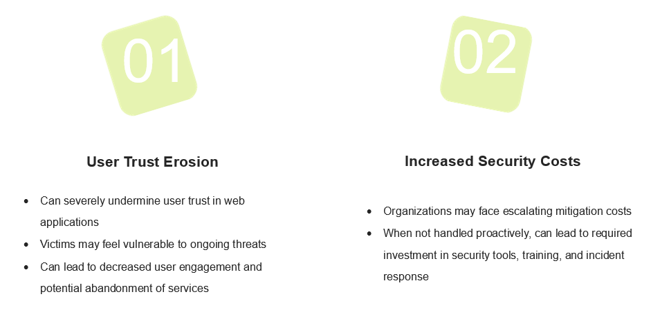
Impact of XSS on Users, Applications, and Enterprises
https://brightsec.com/blog/xss-attack

Slide 113
Prevention Techniques for XSS
Input Validation
CSP Configuration Best Practices
Regular Security Audits
Notes:
Implement strict input validation to ensure only safe data formats are processed, reducing the risk of malicious script injection
Establish a robust Content Security Policy to control resource loading, preventing unauthorized script execution and enhancing application security
Conduct frequent security assessments and code reviews to identify and remediate potential XSS vulnerabilities, ensuring ongoing protection against evolving threats
Encode and validate everywhere – do not trust user inputs, escape outputs, and manage response headers
Use libraries with utility handlers where possible (e.g., Jinja or Django)
Quote every attribute of every tag in HTML
Use HttpOnly directive on custom cookie response headers (i.e., “Set-Cookie” header)
Use the “X-Content-Type-Options: nosniff” to prevent MIME type sniffing (i.e., dynamic changes to Content-Type header)
Leverage network components like WAF with built-in protection to intersect at the network layer
https://cheatsheetseries.owasp.org/cheatsheets/Cross_Site_Scripting_Prevention_Cheat_Sheet.html

Slide 114
LAB:
Follow along with the instructor to setup an account on your VM to access https://tryhackme.com/r/room/owasptop102021. This provides a series of interactive labs for exploring some of the common top 10 vulnerabilities and better understanding each.
OWASP Top 10
Notes:
https://iritt.medium.com/owasp-top-10-tryhackme-walkthrough-f2a8185bcb99
https://medium.com/@corybantic/tryhackme-owasp-top-10-2021-writeup-159ccfadb4d7

Slide 115



Thank you!
If you have additional questions, please reach out to me at:
asanders@gamuttechnologysvcs.com

